Slide 1
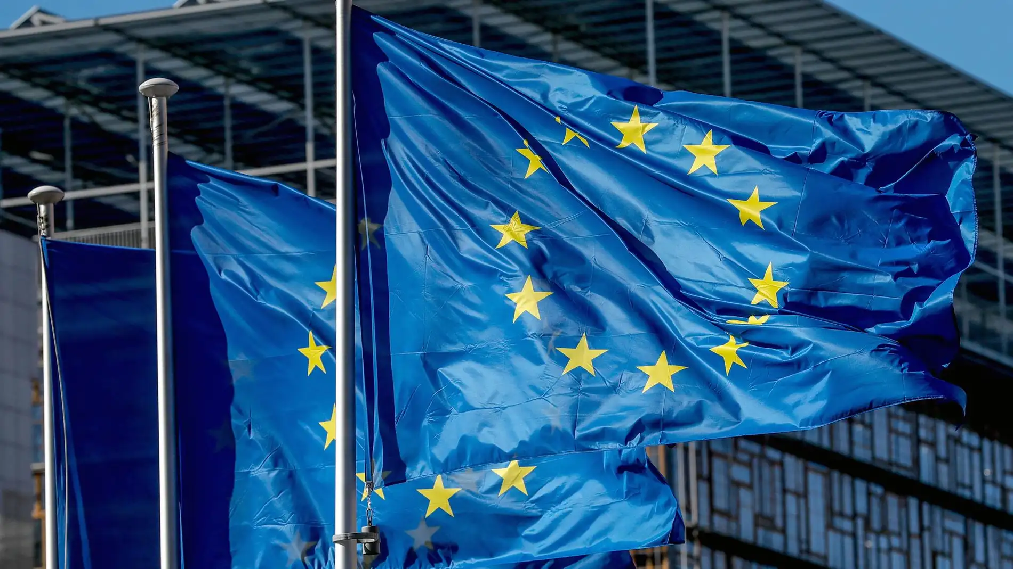
Triangular Cooperation. EU-LATAM
Michel Lapierre Robles, Director LATAM-UE
michel.lapierre@finnova.eu
Notes:
Hello everyone, good morning, the truth is that I am very happy to be here. I think it is a excellent space that CONVALORES opens. I'm going to make some excuses because I'm a little constipated and I need to drink water constantly, otherwise my voice won't come out.
My name is Michel Lapierre, I am the director of Finnova for LATAM.

Slide 2
FINNOVA
FINNOVA Foundation is a Belgian non-profit foundation established in 2009, with headquarters in Brussels and subsidiaries in Spain, Portugal and Chile. The Finnova Foundation is an institution that promotes, both public administrations and private companies, access to the resources, initiatives and programs of the European Union. We work with local and central governments, universities, research and professional training centers, large companies, MSMEs and the start-up ecosystem.
FINNOVA (www.finnova.eu) works in the fields of new technologies, sustainable development, the environment, circularity, energy efficiency and renewable energies, smart cities, bioeconomy, water, waste, tourism and social inclusion, through different European projects and initiatives based on innovation.
Notes:
Finnova is a Belgian foundation dedicated to promoting European policies and financing instruments and we are currently very interested in strengthening cooperation between the EU and LATAM for sustainable development. We work in several areas.
Now we are en different countries.

Slide 3
What is triangular co-operation?
One innovative, promising way of expanding global co-operation for sustainable development
Can provide solutions to overcome today's most pressing environmental, economic and social challenges, ensuring sustainable development in partner countries.
It is a combination of three roles:
The beneficiary partner seeks support to tackle a specific development challenge;
The pivotal partner has proven experience in the issue, and shares its resources, knowledge and expertise;
The facilitating partner connects the beneficiary and the pivotal partners, supporting their collaboration financially and technically.
These roles may change throughout the life of a project.
There can be several actors at each edge of the triangle.
Those actors may be representing countries, international organisations, civil society, private sector, trade unions or private philanthrophy.
Notes:
Roles

Slide 4
Triangular cooperation programmes
There are different TC programmes in all continents. In the LATAM-EU relationship, the most important are:
Adelante2, European Union.
Regional Fund for Triangular Cooperation in Latin America and the Caribbean. German Government.
AECID. Bilateral and multilateral agrees with some LAC countries.

Slide 5
ADELANTE 2
ADELANTE 2 is a European Union programme with the aim of contributing to the fulfilment of the 2030 Agenda in Latin America and the Caribbean, through interventions that reflect the most modern approaches to Triangular Cooperation.
It is a demand-driven instrument, agile and flexible, with a 'rapid response' approach.
Open to all initiatives that address any SDG.
Eligible activities must be knowledge sharing: events (conferences, seminars, workshops), missions (consultancies, study visits and internships), studies and participation in courses. Adelante2 supports initiatives, not projects.
Initiatives last between 6 and 9 months.
ADELANTE Team will directly manage the funds, thus ensuring greater agility and working under the 'rapid response' approach mentioned above.
Notes:
in the sense that there is not a sum of actions on a problem to change it, in the traditional definition of the theory of action, but rather they are initiatives, that is, actions of exchange of experience that allow improving capabilities so that the beneficiary and the local system of actors know how to transform a problem.

Slide 6
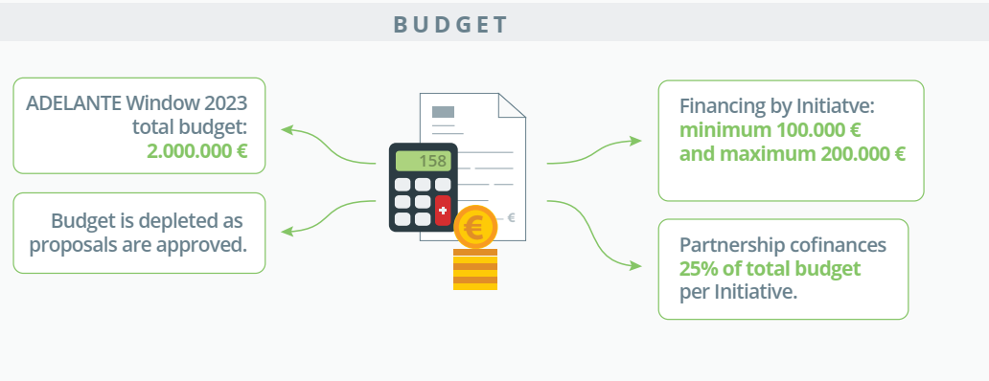

Slide 7
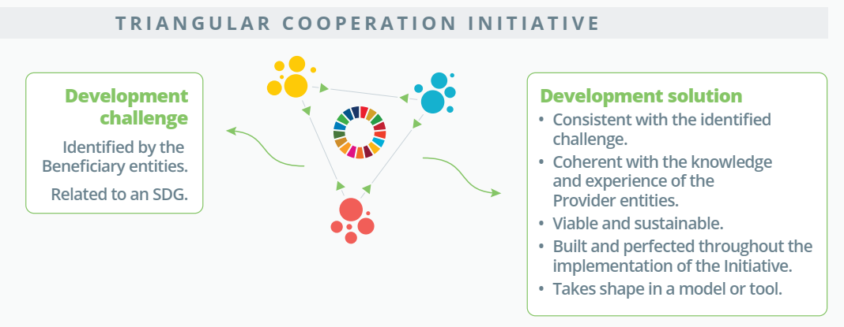

Slide 8
225 entities representing
27 countries in Europe and LAC
9,700 people participating
250 activities
Notes:
some numbers of the program that has been running for a few years. As you can imagine, Adelante2 is the second version of the Adelante program that began in 2010. The current version ends next year, although it is expected that the program will be renewed with the lessons learned from the initiatives already implemented.

Slide 9
Two ways to participate
Adelante window. It opens on a specific date and closes when resources are entirely allocated.
Important!!, in the last call, the platform closed three days after the call was opened!! Therefore, it is important to have the project and the partnership completed y agreed before the call.
Regional call (all LATAM countries are elegible).
April-May.
Triangular cooperation funds in Brazil, Chile, Colombia, Costa Rica, Cuba and Uruguay.
Each mentioned country with EU country to benefit a third LAC country.
It is not a window, but normally the application period lasts around one month from the moment the call opens.
In addition to SDG, each country highlights specific priorities.

Slide 10
ADELANTE 2 SUCCESS CASE EXAMPLE: Sustainability in the fashion sector for its internationalisation
Adelante2 window.
Total budget: 182,696.00 € (116,837 from Adelante2)
Participants:
Bogotá Chamber of Commerce (Colombia) (beneficiary),
the Sustainable Fashion Cluster (Peru) (First provider) and
Finnova (Spain) (second provider).

Slide 11
ADELANTE 2 SUCCESS CASE EXAMPLE: Sustainability in the fashion sector for its internationalisation
To maximise the knowledge of the Partnership's entities on the obligatory requirements and regulations in the framework of the European Green Deal, and other laws or certifications that allow them to access new markets, as well as on strategies for strengthening business models and minimising environmental impacts.
To strengthen the areas of the Bogotá Chamber of Commerce, to raise awareness and appropriate the knowledge of European and Peruvian companies, through the transfer of good practices related to sustainability and circularity, the requirements for market access, within the framework of the European Green Pact and new trends in consumption, supply and demand.
Workshops, seminar, practical guide, training course, study visits, international congress.
Notes:
To know the european norms to acces to new market to Colombian textiles, to know good practices of sustainability and circularity, in this case. This initiative end

Slide 12
Application process
Through a virtual platform in A2window, by sending documents to an email in TCfunds.
A fairly concise form must be completed (In A2windows, the form must be completed in the virtual platform)
A letter of association must be presented between partners.
Evaluation of the proposal in stages*
Notes:
There are different evaluation routes or pathways of the initiative presented. But in both modalities, there is a preliminary evaluation, and if this preliminary evaluation is successful, it moves to a second stage where the proposal and budget must be designed in more detail.

Slide 13
How to apply. Tips
The application deadlines are very short!!, therefore, alliances and initiatives must be defined before the start of the call.
Taking into account the months in which the calls usually open (regional: April, Costa Rica: May, Colombia: October)

Slide 14
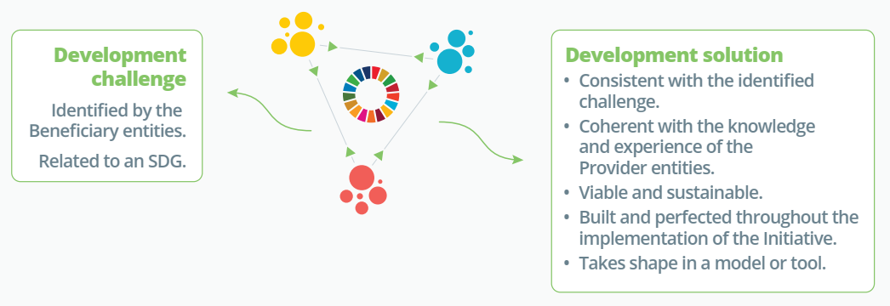
The key: Coherence
Initiatives must address relevant SDG challenges, which have the possibility of scalability, where the partnership has significant expertise to provide experiences and solutions to the challenge.
Coherence between SDG challenge, skills and experiences of the entities and the proposal.
Notes:
Sometimes, due to necessity or motivation, we try to generate partnerships from different countries and that's it, that's it. It is important to understand that it is a very competitive fund, so it is important to make alliances with leading and relevant actors within the selected countries, ensuring that the main beneficiary has an important role in addressing the development challenge, that the first offeror is a country of the Latin American context that has already addressed the issue with good results and a European country with experience in solving the development challenge

Slide 15
Thank you very much!
michel.lapierre@finnova.eu
Notes:
Thank you very much. That was the presentation. I thank ConValores for the space. I hope it was useful And well, as I told you, we as Finnova, we are interested in promoting this type of initiatives, so if you have any idea that you think can be competitive and innovative, and you lack partners and technical support, do not hesitate to write to me. Thank you very much, it was a pleasure.

